Slide 1


Large Language Models Explained
A comprehensive guide to understand LLM practical limits (tokens, context windows, etc.) for advanced AI use

Slide 2
Agenda
Why LLM Mechanics Matter for Advanced Users
Tokens - What it is, Token Economics
Context Window - What it is, The Impact on Advanced Use
Identifying Token and Context Issues
Strategic Model Selection
Optimization Strategies for Maximizing Efficiency Within Constraints
Multi-Modal Capabilities and Token Implications
Error Handling
Staying Ahead of Rapid LLM Evolution
Applying Token Knowledge in Course Sections

Slide 3

Why LLM Mechanics Matter?
Understanding the technical foundations of Large Language Models directly impacts your project's success, efficiency, and cost-effectiveness.
Mastering key concepts like tokens, context windows, and prompt engineering isn't just technical knowledge—it's the difference between mediocre and exceptional AI-powered tools.

Slide 4
What Are Tokens?
Tokens = The Currency of AI Interaction
Definition: Tokens are the smallest units of text that LLMs can process - roughly equivalent to words, word parts, or characters.
Practical Examples:
"Hello world" = 2 tokens
"ChatGPT" = 2 tokens (Chat + GPT)
"AI" = 1 token
"don't" = 2 tokens (don + 't)
Why It Matters?
Cost Calculation
Context Limits
Performance Impact
You pay per token processed
Models have maximum token budgets per conversation / per output
More tokens = slower processing

Slide 5
Token Economics
Let's understand the real impact on your projects:
Cost Structure
Performance Factors
Input Tokens: What you send to the model (prompts, context, files)
Processing Speed: More tokens = longer response times
Memory Usage: Large token counts require more computational resources
Output Tokens: What the model generates back
Different Pricing: Input tokens typically cost less than output tokens
Quality Impact: Very long inputs can dilute attention to key information
Strategic Decisions
When to summarize vs. send full context
How to structure custom GPT instructions efficiently
Which model to choose based on token requirements vs. cost

Slide 6
Identifying Token and Context Issues
Warning Signs
1
Truncated Responses
2
"Forgetting" Earlier Context
Model stops mid-sentence or cuts off
References to earlier conversation parts disappear
3
Inconsistent Responses
4
Error Messages
Model behavior changes unexpectedly during long sessions
Direct notifications about context length limits
Immediate Solutions:
1
Start New Conversations
2
Summarize Key Points
Reset context window
Condense important information before continuing
3
Switch Models
4
Break Down Tasks
Use models with larger context windows
Divide complex requests into smaller parts

Slide 7
Context Windows
The Conversation Memory Boundary
What Is a Context Window?
The maximum number of tokens a model can "remember" in a single conversation
Includes everything: system prompts, conversation history, your current input, and the response being generated
Think of context windows like RAM in your computer - when full, older information gets "forgotten" to make room for new information.
Context window sizes is different for each model and changes rapidly!
Model
Context Window
GPT‑4 (base)
~8 K tokens
GPT‑4 (variant)
32 K tokens
GPT‑4 Turbo / GPT‑4o
128 K tokens
GPT‑4.1 family
1 million
o3-mini / o3
200 K tokens
Gemini 1.5/2.5 Pro
1 million
Claude Sonnet
~200 K tokens

Slide 8



Context Window Impact
Custom GPT Limitations
Your Instructions + knowledge files + conversation = total token count
Long instruction sets reduce available space for user interactions —> Need to balance comprehensive instructions with conversation capacity
Data Analysis Projects
Large datasets may exceed context windows —> Requires chunking strategies or data summarization
No-Code Application Design
Chat interfaces need token management for long conversations.
File processing tools must handle token limits gracefully, because user may experience context lost mid-conversation

Slide 9
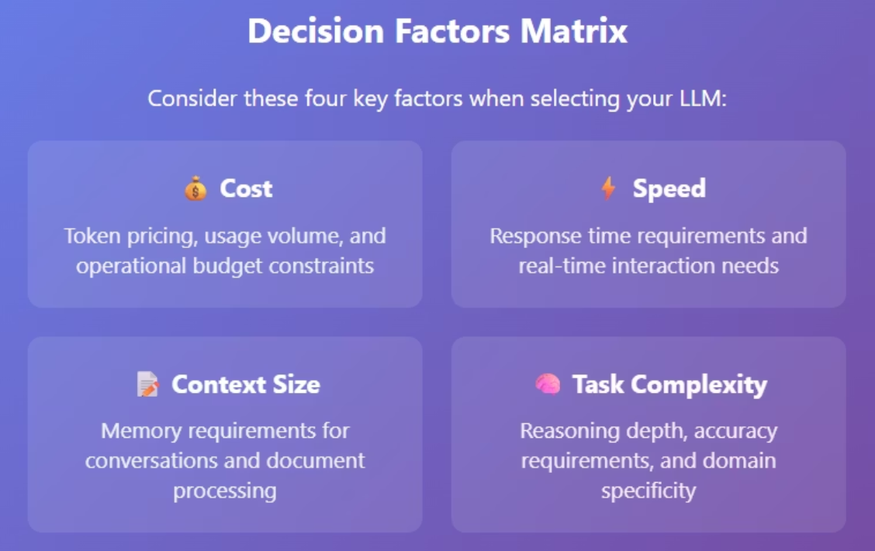
Strategic Model Selection

Slide 10



Optimization Strategies for Maximizing Efficiency Within Constraints
Prompt Engineering for Token Efficiency
Concise Instructions: Get to the point quickly in custom GPT instructions
Template Reuse: Create reusable prompt templates to reduce repeated token usage
Structured Outputs: Request specific formats to avoid verbose responses
Context Management
Rolling Summaries: Periodically summarize conversation history
Chunked Processing: Break large tasks into smaller, manageable pieces
Selective Context: Include only relevant previous conversation parts
Application Design
Stateless Interactions: Design conversations that don't rely heavily on prior context
External Memory: Store important information outside the conversation context
Progressive Disclosure: Reveal information gradually rather than all at once

Slide 11




Multi-Modal Capabilities and Token Implications
Multi-modal features (e.g. images, audio, data files, code) dramatically increase token usage
Multi-Modal Token Consumption:
Images
Audio
Code
Files
Can consume 100-1,000+ tokens depending on size and complexity
Converted to text, then processed as tokens
Treated as text tokens, but can be token-heavy
PDF / pptx - converted to text tokens for processing
Data files (xlsx, csv) - convert to python data frame
Strategic Considerations:
File Size Limits: Large files may exceed context windows entirely
Quality vs. Efficiency: Higher resolution images provide better analysis but cost more
Format Choice: Text files more efficient than images for text content
Preprocessing: Consider extracting text from images before AI processing

Slide 12

Error Handling
Common Failure Scenarios
Context Overflow: User conversations exceed model limits
Rate Limiting: Too many requests in short time periods
Model Unavailability: Service outages or maintenance
Cost Limits: Budget caps reached mid-session
Design for Resilience
Fallback Models: Switch to smaller/cheaper models when needed
Graceful Truncation: Intelligently summarize rather than cut off abruptly
Progressive Loading: Load content incrementally rather than all at once

Slide 13
Staying Ahead of Rapid LLM Evolution
Current Trends
Increasing Context Windows
Decreasing Costs
Specialized Models
Models are getting larger memory capacity
Token prices generally trending downward
More domain-specific options appearing

Slide 14

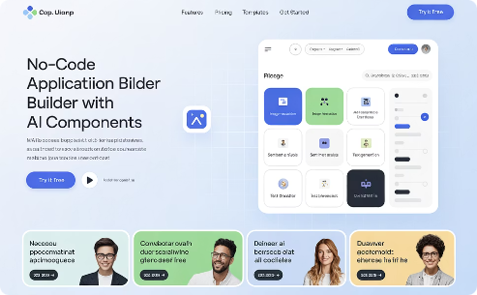
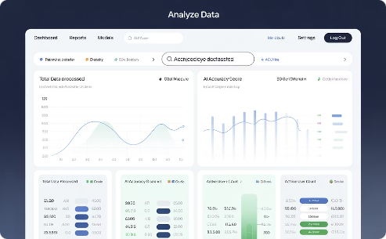
Applying Token Knowledge in Course Sections
Token and context decisions directly impact project outcomes.
Custom GPT Development
Prototyping and Vibe-Coding Tools
Data Analysis and Decision Making
Craft instructions that optimize token usage
Be aware of reaching the context limit of the conversation / token limit
Choose between chunking and larger context windows
Structure knowledge bases efficiently
Remember prompt engineering!
Balance analysis depth with efficiency
Design interactions within context limits
Split analysis to different conversations

Slide 15



Key Takeaways
Tokens are your currency
Optimize your prompt and attached files for efficiency without sacrificing functionality
Context windows are your memory
When you hit the limit, move to a new conversation.
Model selection is strategic
Match capabilities of the models to requirements - Chat GPT great with data analysis, Claude great with prototyping, etc.

Slide 16
Questions?

